Slide 1

Chapter 9
Security
9.1 - 9.3
Environment
Basics of Cryptography
Protection Mechanisms
Tanenbaum, Modern Operating Systems 3 e, (c) 2008 Prentice-Hall, Inc. All rights reserved. 0-13-6006639

Slide 2
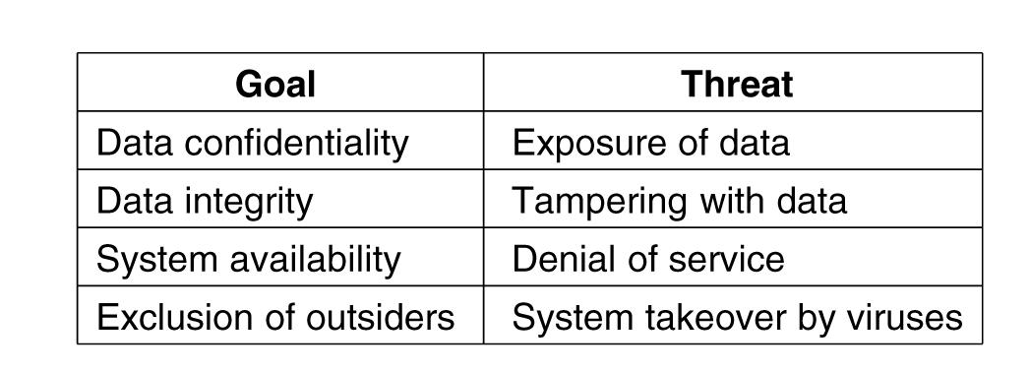
Threats
Figure 9-1. Security goals and threats.
Tanenbaum, Modern Operating Systems 3 e, (c) 2008 Prentice-Hall, Inc. All rights reserved. 0-13-6006639

Slide 3
Intruders
Common categories:
Casual prying by nontechnical users.
Snooping by insiders.
Determined attempts to make money.
Commercial or military espionage.
Tanenbaum, Modern Operating Systems 3 e, (c) 2008 Prentice-Hall, Inc. All rights reserved. 0-13-6006639

Slide 4
Accidental Data Loss
Common causes of accidental data loss:
Acts of God: fires, floods, earthquakes, wars, riots, or rats gnawing backup tapes.
Hardware or software errors: CPU malfunctions, unreadable disks or tapes, telecommunication errors, program bugs.
Human errors: incorrect data entry, wrong tape or CD-ROM mounted, wrong program run, lost disk or tape, or some other mistake.
Tanenbaum, Modern Operating Systems 3 e, (c) 2008 Prentice-Hall, Inc. All rights reserved. 0-13-6006639

Slide 5
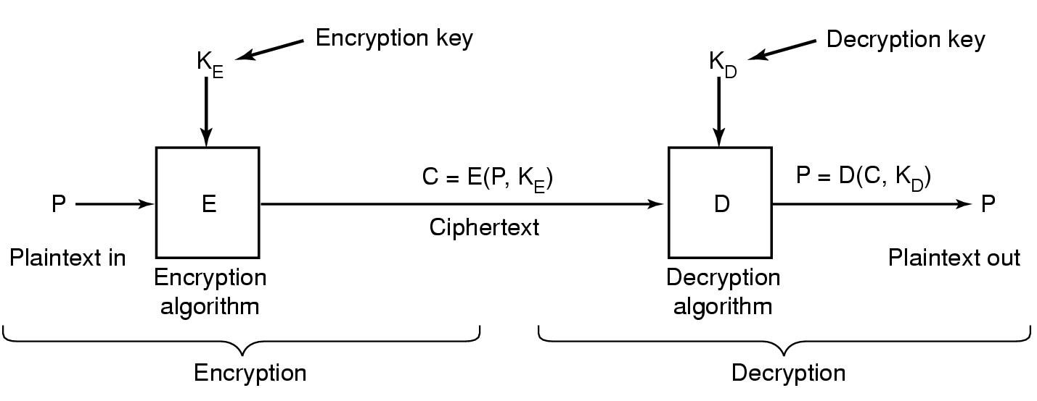
Basics Of Cryptography
Figure 9-2. Relationship between the plaintext and the ciphertext.
Tanenbaum, Modern Operating Systems 3 e, (c) 2008 Prentice-Hall, Inc. All rights reserved. 0-13-6006639

Slide 6
Secret-Key Cryptography
Monoalphabetic substitution:
Plaintext: ABCDEFGHIJKLMNOPQRSTUVWXYZ
Ciphertext: QWERTYUIOPASDFGHJKLZXCVBNM
Tanenbaum, Modern Operating Systems 3 e, (c) 2008 Prentice-Hall, Inc. All rights reserved. 0-13-6006639

Slide 7
Public-Key Cryptography
Encryption makes use of an "easy" operation, such as how much is
314159265358979 × 314159265358979?
Decryption without the key requires you to perform a hard operation, such as what is the square root of 3912571506419387090594828508241?
Tanenbaum, Modern Operating Systems 3 e, (c) 2008 Prentice-Hall, Inc. All rights reserved. 0-13-6006639

Slide 8
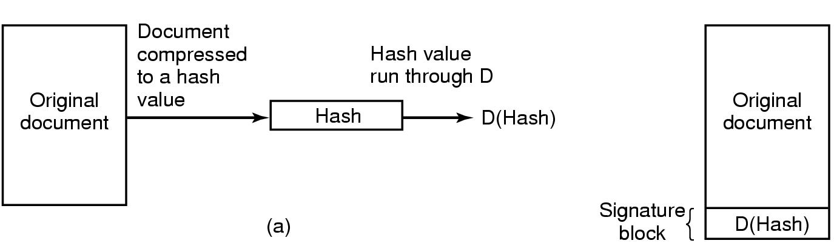
Digital Signatures
Figure 9-3. (a) Computing a signature block.
(b) What the receiver gets.
Tanenbaum, Modern Operating Systems 3 e, (c) 2008 Prentice-Hall, Inc. All rights reserved. 0-13-6006639

Slide 9
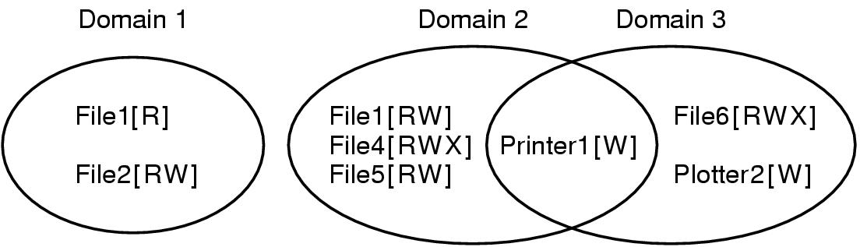
Protection Domains (1)
Figure 9-4. Three protection domains.
Tanenbaum, Modern Operating Systems 3 e, (c) 2008 Prentice-Hall, Inc. All rights reserved. 0-13-6006639

Slide 10
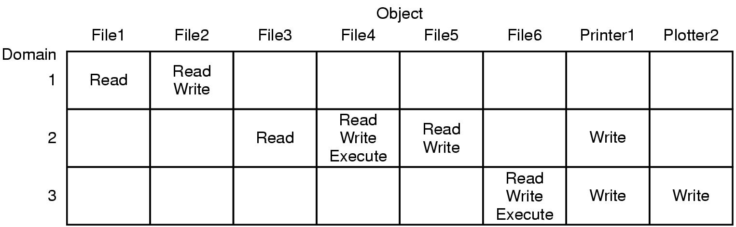
Protection Domains (2)
Figure 9-5. A protection matrix.
Tanenbaum, Modern Operating Systems 3 e, (c) 2008 Prentice-Hall, Inc. All rights reserved. 0-13-6006639

Slide 11
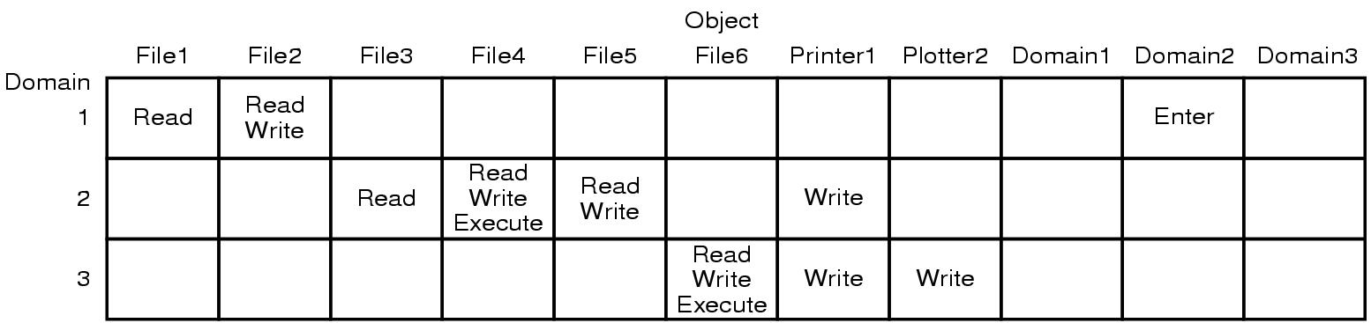
Protection Domains (3)
Figure 9-6. A protection matrix with domains as objects.
Tanenbaum, Modern Operating Systems 3 e, (c) 2008 Prentice-Hall, Inc. All rights reserved. 0-13-6006639

Slide 12
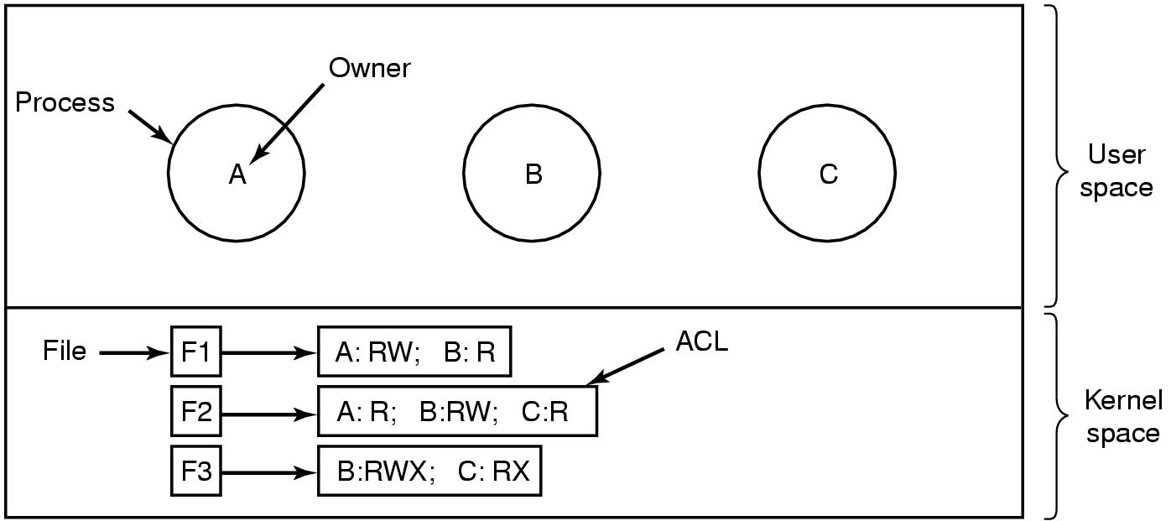
Access Control Lists (1)
Figure 9-7. Use of access control lists to manage file access.
Tanenbaum, Modern Operating Systems 3 e, (c) 2008 Prentice-Hall, Inc. All rights reserved. 0-13-6006639

Slide 13
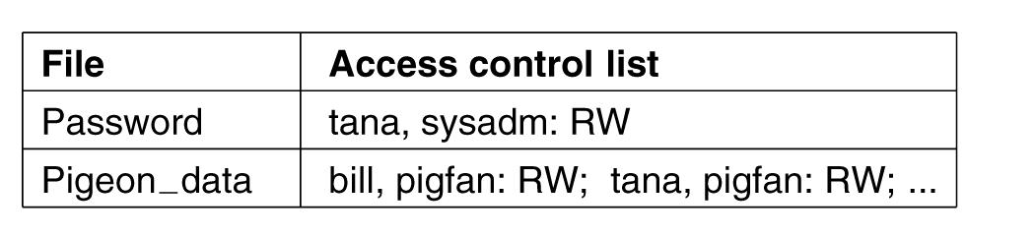
Access Control Lists (2)
Figure 9-8. Two access control lists.
Tanenbaum, Modern Operating Systems 3 e, (c) 2008 Prentice-Hall, Inc. All rights reserved. 0-13-6006639

Slide 14
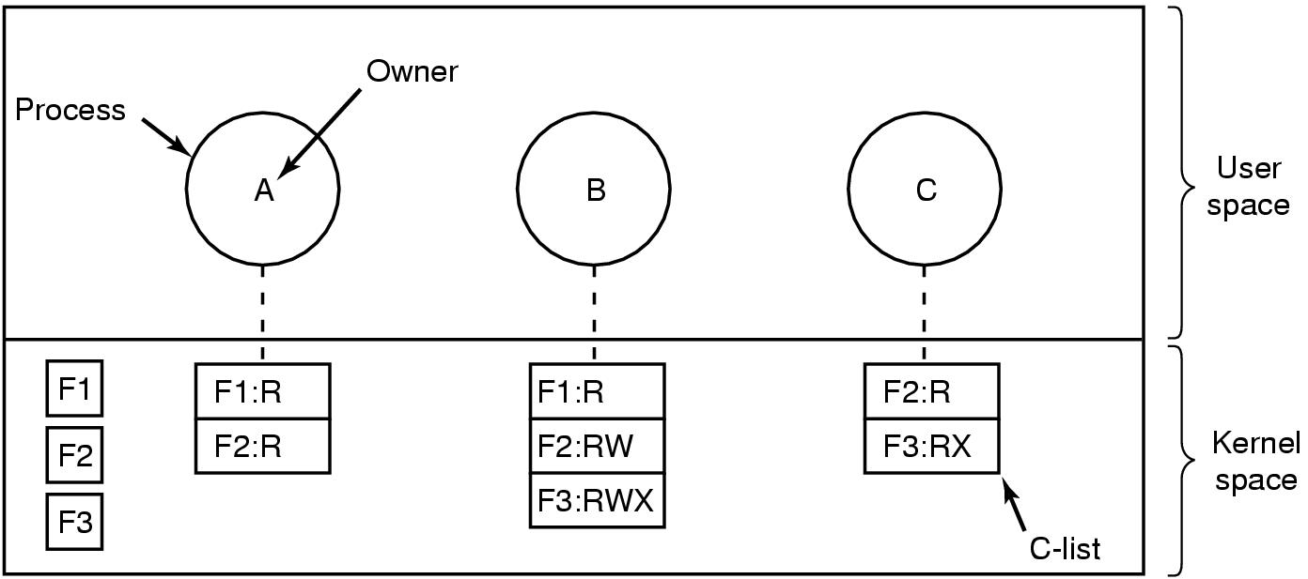
Capabilities (1)
Figure 9-9. When capabilities are used,
each process has a capability list.
Tanenbaum, Modern Operating Systems 3 e, (c) 2008 Prentice-Hall, Inc. All rights reserved. 0-13-6006639

Slide 15
Capabilities (2)
Figure 9-10. A cryptographically protected capability.
Tanenbaum, Modern Operating Systems 3 e, (c) 2008 Prentice-Hall, Inc. All rights reserved. 0-13-6006639

Slide 16
Capabilities (3)
Examples of generic rights:
Copy capability: create a new capability for the same object.
Copy object: create a duplicate object with a new capability.
Remove capability: delete an entry from the C-list; object unaffected.
Destroy object: permanently remove an object and a capability.
Tanenbaum, Modern Operating Systems 3 e, (c) 2008 Prentice-Hall, Inc. All rights reserved. 0-13-6006639

Slide 17
Trusted Systems
Consider reports of viruses, worms, etc.
Two naive (but logical) questions:
Is it possible to build a secure computer system?
If so, why is it not done?
Tanenbaum, Modern Operating Systems 3 e, (c) 2008 Prentice-Hall, Inc. All rights reserved. 0-13-6006639

Slide 18
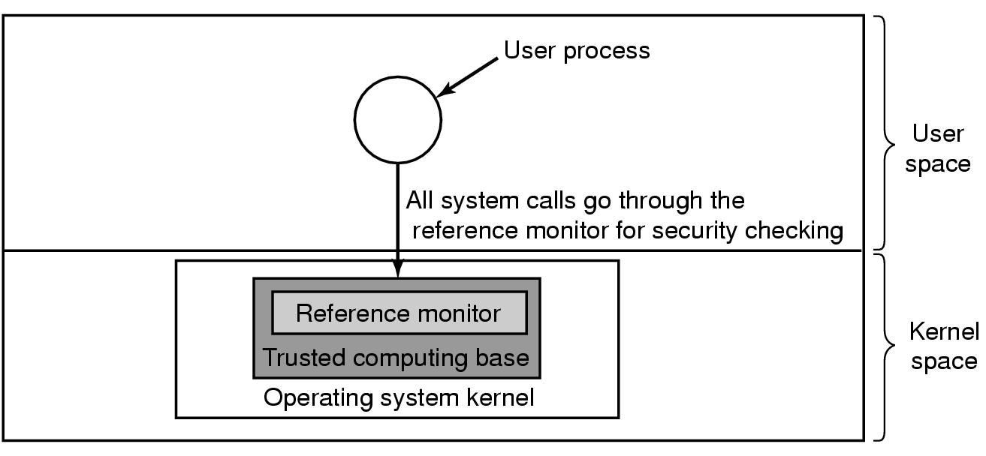
Trusted Computing Base
Figure 9-11. A reference monitor.
Tanenbaum, Modern Operating Systems 3 e, (c) 2008 Prentice-Hall, Inc. All rights reserved. 0-13-6006639

Slide 19
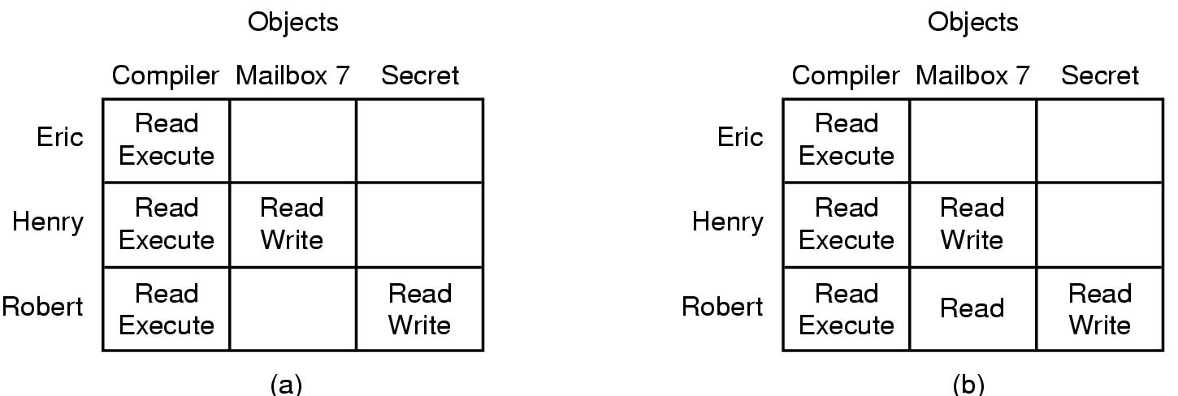
Formal Models of Secure Systems
Figure 9-12. (a) An authorized state. (b) An unauthorized state.
Tanenbaum, Modern Operating Systems 3 e, (c) 2008 Prentice-Hall, Inc. All rights reserved. 0-13-6006639

Slide 20
The Bell-La Padula Model (1)
Rules for the Bell-La Padula model:
The simple security property: A process running at security level k can read only objects at its level or lower.
The * property: A process running at security level k can write only objects at its level or higher.
Tanenbaum, Modern Operating Systems 3 e, (c) 2008 Prentice-Hall, Inc. All rights reserved. 0-13-6006639

Slide 21
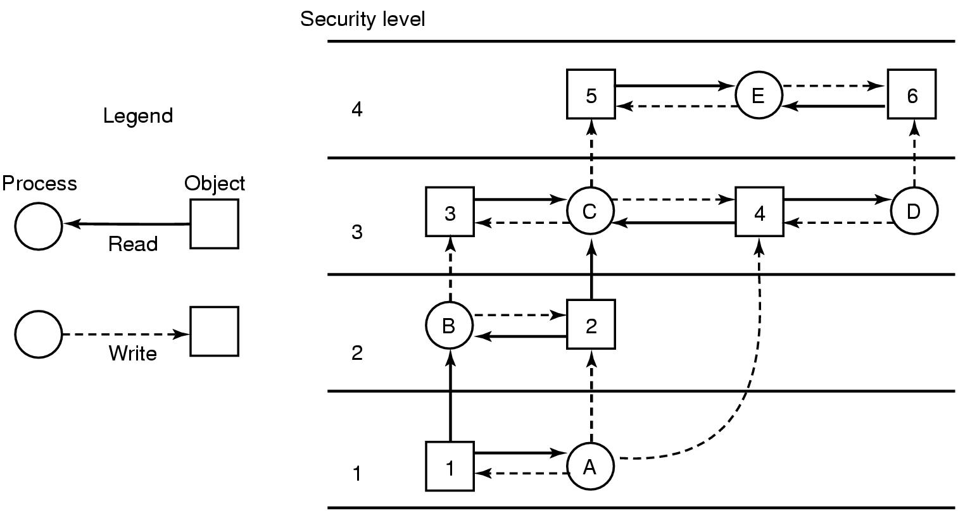
The Bell-La Padula Model (2)
Figure 9-13. The Bell-La Padula multilevel security model.
Tanenbaum, Modern Operating Systems 3 e, (c) 2008 Prentice-Hall, Inc. All rights reserved. 0-13-6006639

Slide 22
The Biba Model
Rules for the Biba model:
The simple integrity principle: A process running at security level k can write only objects at its level or lower (no write up).
The integrity * property: A process running at security level k can read only objects at its level or higher (no read down).
Tanenbaum, Modern Operating Systems 3 e, (c) 2008 Prentice-Hall, Inc. All rights reserved. 0-13-6006639

Slide 23
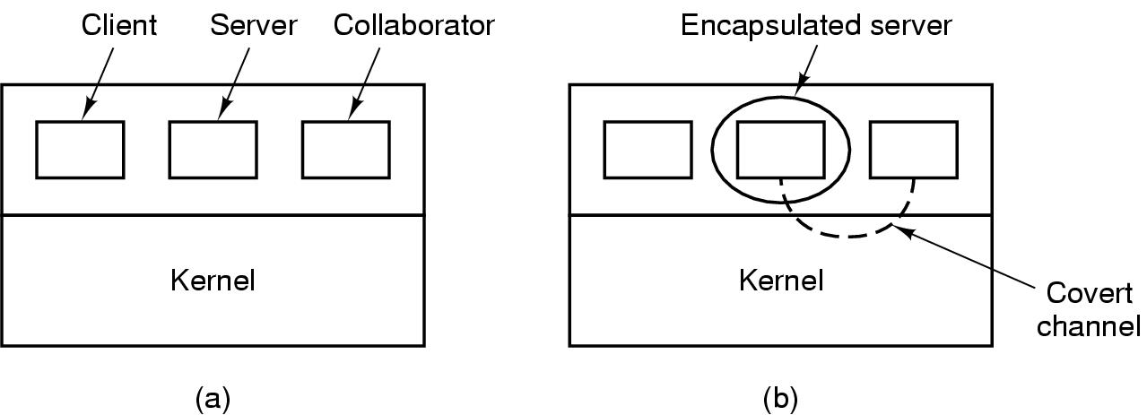
Covert Channels (1)
Figure 9-14. (a) The client, server, and collaborator processes. (b) The encapsulated server can still leak to the collaborator via covert channels.
Tanenbaum, Modern Operating Systems 3 e, (c) 2008 Prentice-Hall, Inc. All rights reserved. 0-13-6006639

Slide 24
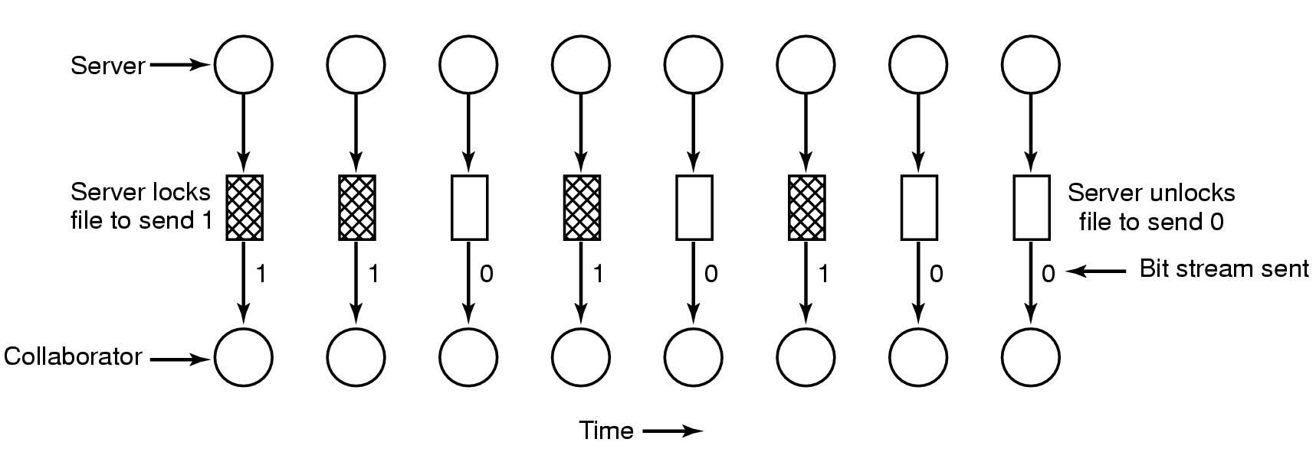
Covert Channels (2)
Figure 9-15. A covert channel using file locking.
Tanenbaum, Modern Operating Systems 3 e, (c) 2008 Prentice-Hall, Inc. All rights reserved. 0-13-6006639

Slide 25
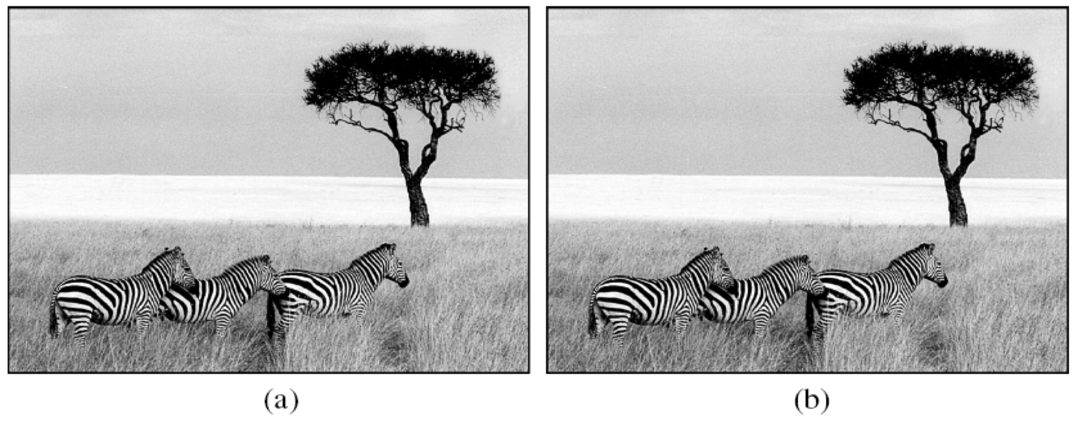
Covert Channels (3)
Figure 9-16. (a) Three zebras and a tree. (b) Three zebras, a tree, and the complete text of five plays by William Shakespeare.
Tanenbaum, Modern Operating Systems 3 e, (c) 2008 Prentice-Hall, Inc. All rights reserved. 0-13-6006639

